Slide 1
Co-Author Based Academic Recommendation System

Slide 2
1
2
3
4
5
6
BACKGROUND
DATA
ALGORITHM
PREPROCESS
RESULT
NEXT
CONTENTS

Slide 3
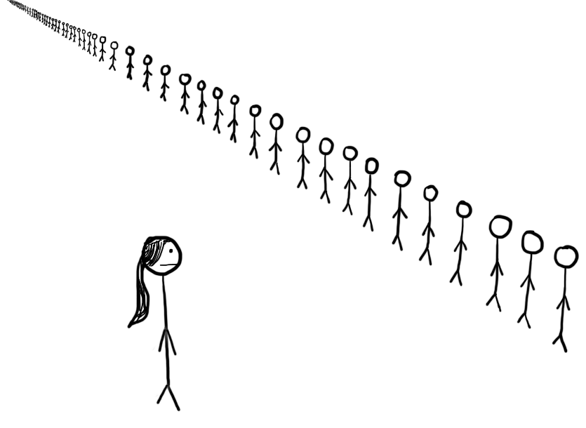

Why We Choose This Topic?
Whom To Cooperate With?
Which Paper To Read?
When they are to write a new paper, researchers always seek co-authors who are knowledgeable on the paper’s subject
Researchers have to read papers chosen from tons of papers to become familiar with the study fields

Slide 4


Why We Choose This Topic?
What We Want?
Take the author professional specialization and research experience into consideration!

Slide 5
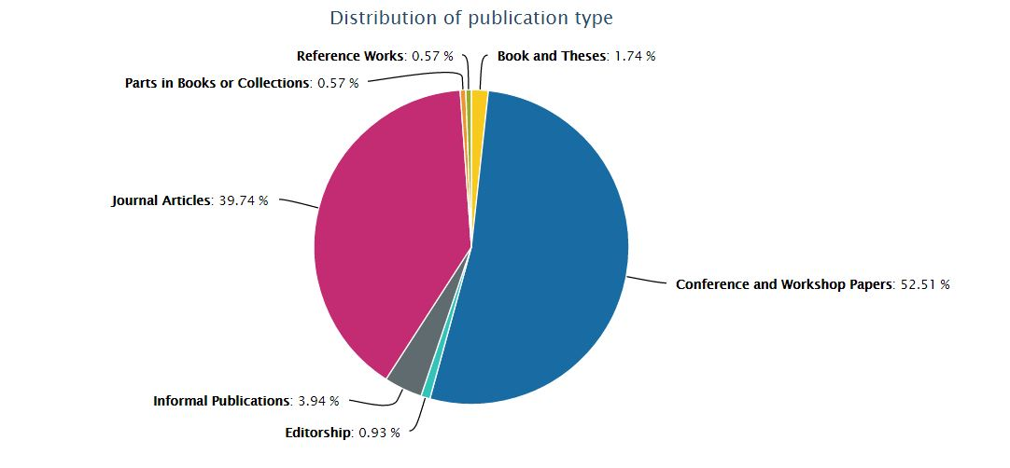
DBLP Computer Science Bibliography
What is it?
On-line reference for bibliographic information on major computer science publications.
标签文字
标签文字
How large is it?
DBLP contains 3,749,969 publications written by 1,899,133 authors and published on 4,112 conferences and 1,525 journals.

Slide 6
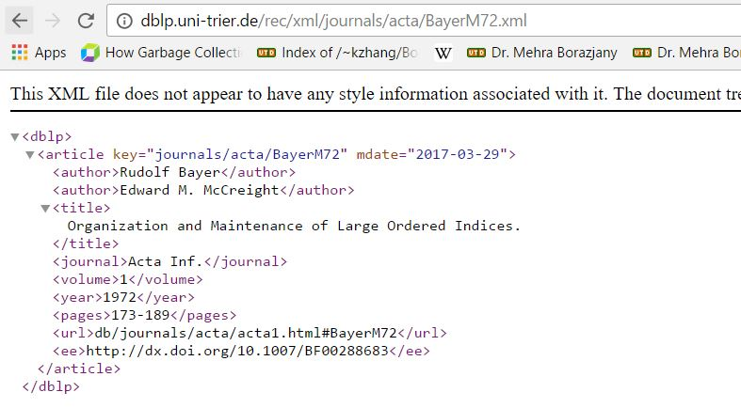
DBLP Computer Science Bibliography
How Does it Look Like?
It’s well-formed in XML file.
The website also provide URLs to retrieve specified record.
标签文字
标签文字

Slide 7
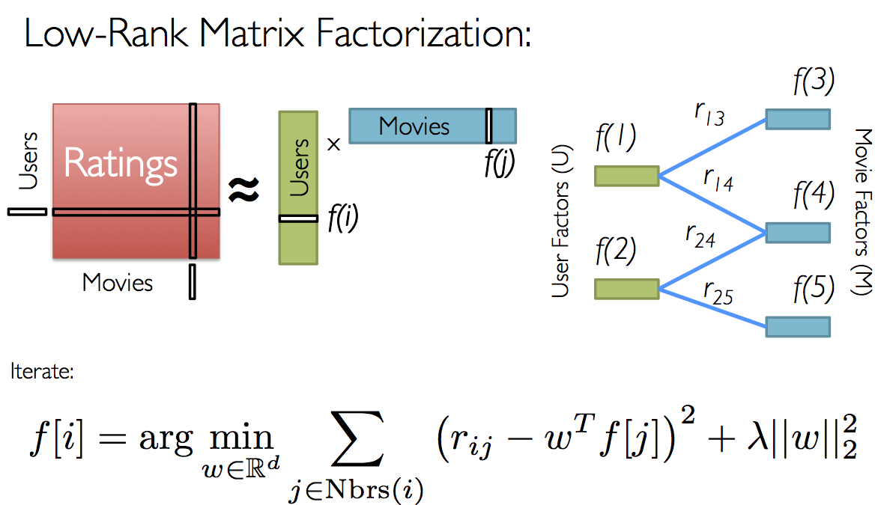
Collaborative Filtering With ALS

Slide 8
Collaborative Filtering With ALS
Domain Free
A
Provide Generally Better Prediction
B
Convert Nonconvex Problem Into Two Quadric Problems
C
Can Be Easily Parallelized On Distributed Computing System
D
E
Cold Start Problem

Slide 9
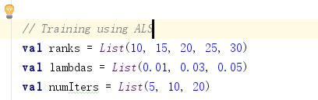
Collaborative Filtering With ALS
Only consider the (author, author) pair with rating 1.
Split whole data set into training(60%), test(20%), validation(20%).
The rank parameter was tuned from [10, 15, 20, 25, 30]
The lambda parameter was tuned from [0.01, 0.03, 0.05]
The #iteration parameter was tuned from [5,10,20]

Slide 10
Data Preprocessing
Weak Connections Are Filtered
Reduce Scale of Training Dataset & Improve Training Efficiency
#Cooperation < 3
Undirected Acyclic Graph

Slide 11
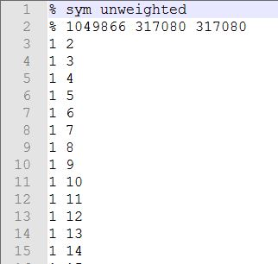
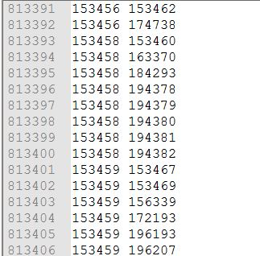
Data Preprocessing
Co-Author Dataset
Author-Paper Dataset

Slide 12
Experiment Result
The best model of co-author dataset is trained with:
The best model of author-paper dataset is trained with:
rank | 30
lambda | 0.05
#iterations | 20
Training MSE | 0.1307
Testing MSE | 0.1312
rank | 30
lambda | 0.05
#iterations | 20
Training MSE | 0.3165
Testing MSE | 0.3161

Slide 13
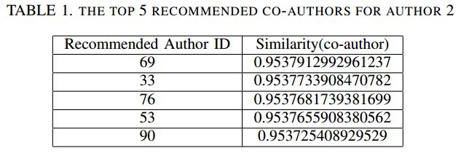
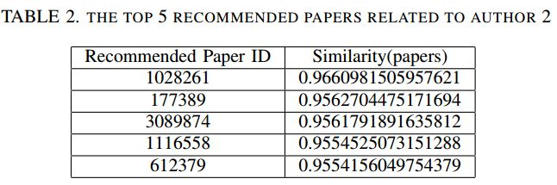
Experiment Result
2
2

Slide 14

What’s Next?
The recommendation model is trained well with our data as it gives minimal mean square error to our dataset.
However there are still some improvements can be made to make our recommendation system better.
Remember?
For each connection (author-author / author-paper) were abstracted into 1 and 0 after filtering by the number of co-existence.
How To Improve It In The Future?
Target Locked!
Weighting ratings by the number of connections and normalize them.
1?
Nice Recommendation!
AND

Slide 15
Thank You!
Presented By:
Mingyue Sun, Fei Chen, Tim Lawrance Fiebrantz, Xiangru Zhou, Xiangdong Wu, Yanjun Xiong

